Slide 1
Message Authentication
Presented By
Riya Mondal

Slide 2
CONTENT
1. Message authentication
2. Message cryptography
2.1 Asymmetric key encryption
3. Hash functions
4. Message authentication code

Slide 3
MESSAGE AUTHENTICATION
Message authentication is concerned with :
Protecting the integrity of a message
Validating identity of originator
Non-repudiation of origin(dispute resolution)
Will consider the security requirements
Three alternative functions used:
Message encryption
Hash functions
Message Authentication Code(MAC)

Slide 4
2. MESSAGE CRYPTOGRAPHY
2.1 ASYMMETRIC MESSAGE ENCRYPTION
Asymmetric cryptography, also known as public-key cryptography
Two different keys are:
lock or encrypt the plaintext
unlock or decrypt the cyphertext
Users can "sign" messages by encrypting them with their private keys
Users can send secret messages by encrypting a message with the recipient's public keys

Slide 5
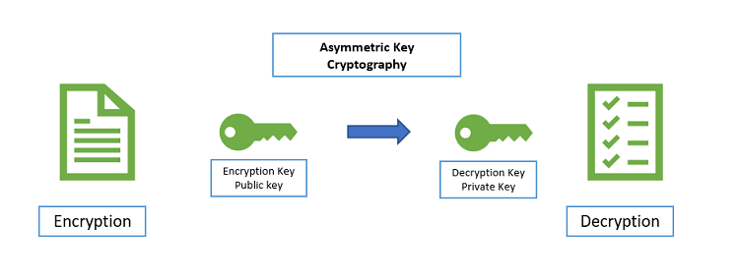
2.3 ASYMMETRIC ENCRYPTION

Slide 6
2.4 PUBLIC –KEY MESSAGE ENCRYPTION
If public-key encryption is used:
Encryption provides no confidence of sender
Since anyone potentially knows public-key
However if
Sender signs message using their private-key
Then encrypts with recipients public key
Have both secrecy and authentication
Again need to recognize corrupted messages
But at cost of two public-key uses on message

Slide 7
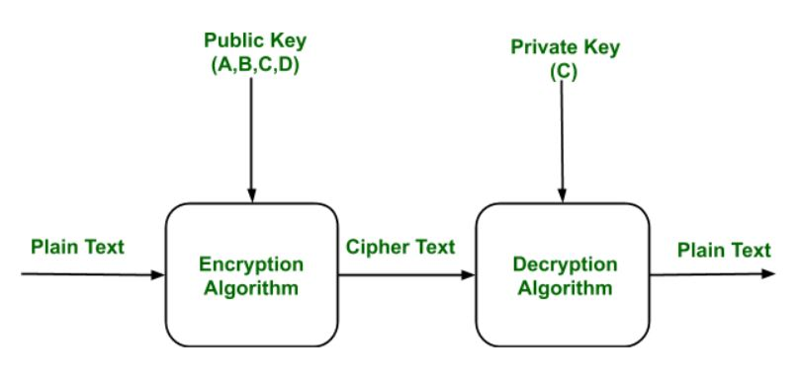
2.5 PUBLIC-KEY ENCRYPTION

Slide 8
3.HASH FUNCTIONS
Condenses arbitrary message to fixed size
h=H(M)
Usually assume hash function is public
Hash used to detect changes to message
Want a cryptographic hash function
Computationally infeasible to find data mapping to specific
hash(one-way property)
Computationally infeasible to find two data to same hash
(collision-free property)

Slide 9
4.MESSAGE AUTHENTICATION CODE(MAC)
Generated by an algorithm that creates a small fixed-sized block
Depending on both message and some key
Like encryption though need not be reversible
Appended to message as a signature
Receiver performs same computation on message and checks it matches the MAC
Provides assurance that message is unaltered and comes from sender

Slide 10
Thank you

